Slide 1
Software Development In Agile

Slide 2
Team Structure
Project Owner (Scrum Master)
BA (Business Analyst)
Developers
QA (Quality Assurance)
Customer/ Client

Slide 3
Project Structure
Project
Sprint 1
Story 1 2-3 weeks
Story 2 Delivery
Story 3
Sprint 2
Story 1 2-3 weeks
Story 2 Delivery
Story 3
Sprint 3
Story 1 2-3 weeks
Story 2 Delivery
Story 3
…Cont.

Slide 4
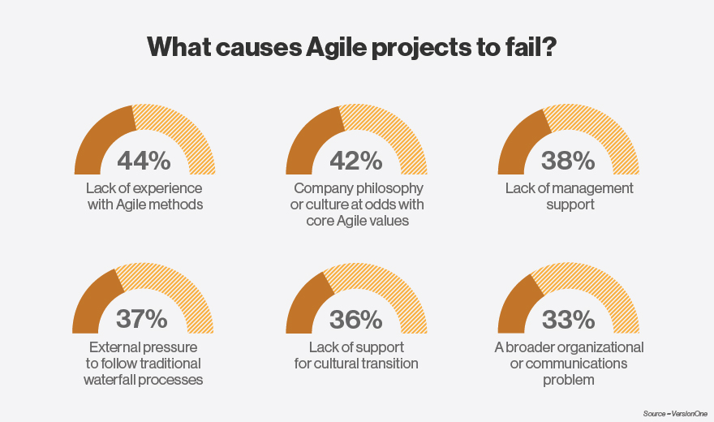
Important Facts about Agile

Slide 5
Point of Success in Agile
Communication Internal/External
Feedback, Suggestions external / internal
Planning
Abilities
Responsibilities
Punctuality

Slide 6
Responsibilities
Business Analyst (BA)
First point of contact for client, Scrum Master, QA.
Responsibilities:-
Requirements Elicitation (gathering, understanding, reviewing, and articulating the needs of the stakeholders)
Analysis (checking for consistency and completeness)
Specification (documenting the requirements)
Validation (making sure the specified requirements are correct)
Locking (Project sign off)

Slide 7
Responsibilities
Project Owner/ Scrum Master
First point of contact for Development team , QA.
Responsibilities:-
Facilitates Sprint Planning, Review & Retrospective
Finds and works to remove roadblocks
Responsible for keeping release/project information consolidated, organized and up to date
Facilitates communication between roles for every aspect of the project
Responsible for throughput (team velocity)
Drives the execution of sprint items

Slide 8
Responsibilities
Development Team
Responsibilities:-
Estimates size of story items
Translation of story items into engineering design and logical units of work (tasks)
Evaluation of technical feasibility
Implementation of story items
Writes and verifies code which adheres to the acceptance criteria
Application of product development best practices

Slide 9
Responsibilities
QA (Quality Analyst)
Responsibilities:-
Writes test cases which enforce the acceptance criteria of features
Keeps all test plans and cases updated to changing requirements
Notifies when production is blocked due to errors in development
Improving Quality
Enforces QA Best Practices

Slide 10
How Cycle works
Week 1
Dev. Team :- Req Analysis (Sprint1), Story creation, allocation, Scheduling, Suggestions, Prepare development base.
QA: - Req. Analysis, Review Project scope with BA, Test Planning, Review Sprint stories to plan test.
Week 2
Dev Team - Start development according to stories planning
QA - Start Test Cases generation, Test case Review and Rework
Week 3
Dev. Team: Finish Development and Work on defects reported by QA
QA: Test Execution, Defect Reporting, Retesting & Close all open issues.
PM / SM : Internal Demo/ Client Demo

Slide 11
Q&A

